Slide 1
Topic: Parabolas EQ: How do parabolas change positions?

Slide 2

Parabolas are also used in arches and architecture

Slide 3
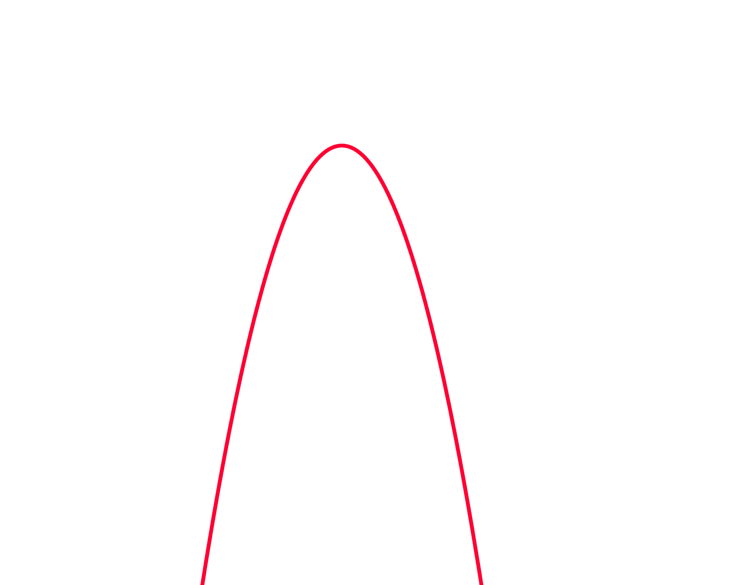
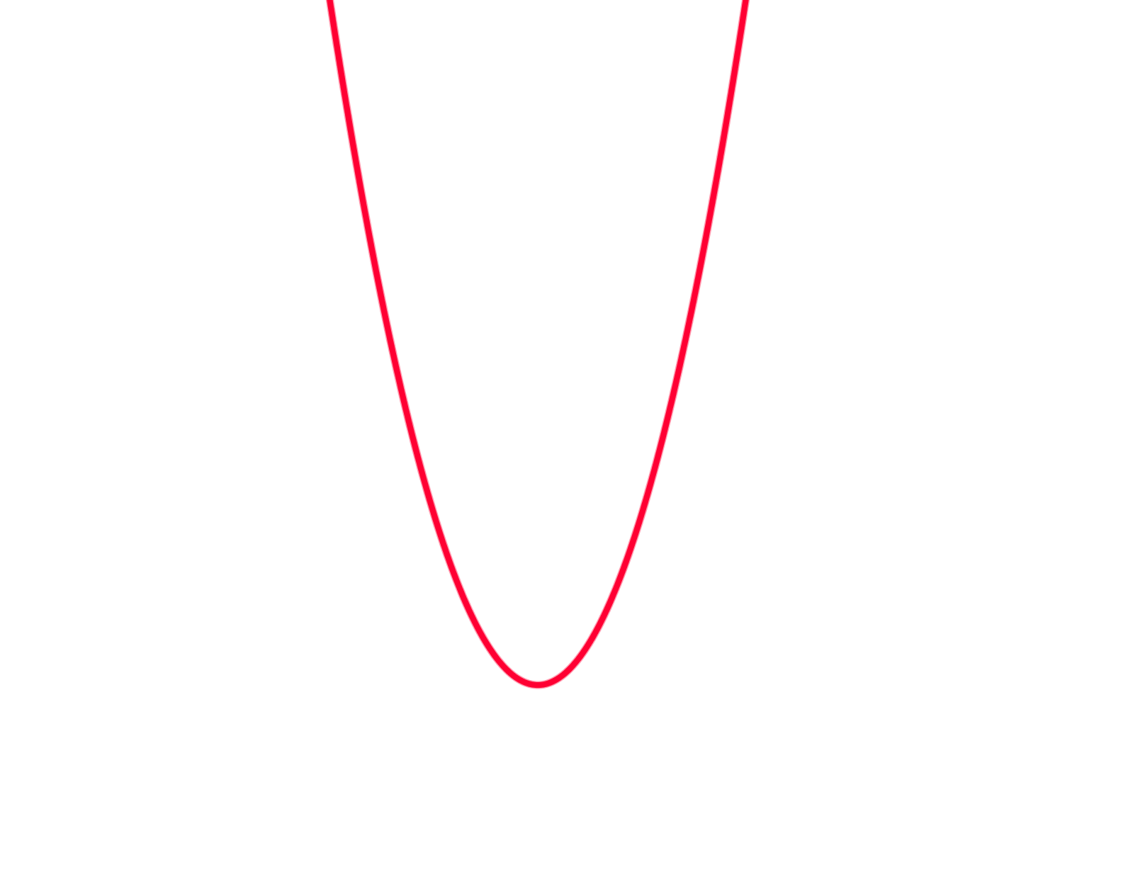


TOPIC: Parabolas
EQ: How do parabolas change positions?
This is a positive parabola
This is a negative parabola

Slide 4
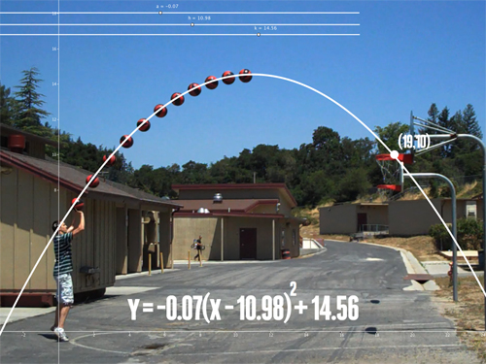
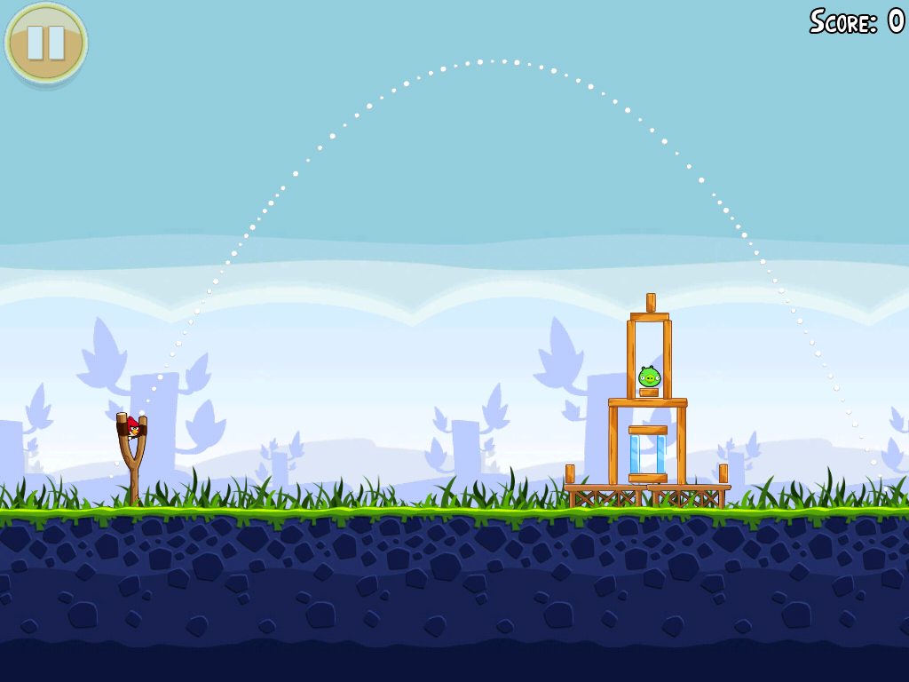
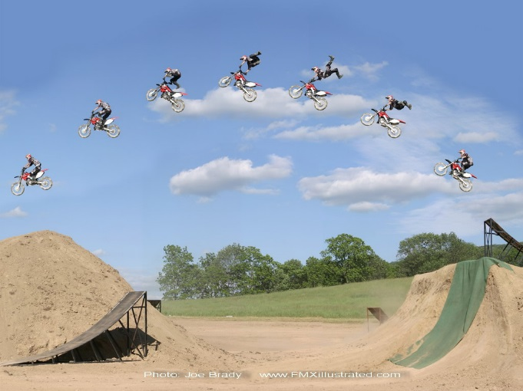
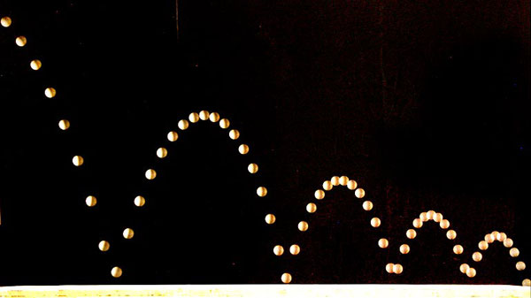
Objects affected by gravity follow a parabolic arc.

Slide 5

TOPIC: Parabolas
EQ: How do parabolas change positions?
$$y={ax}^{2}+b+c$$
The above equation is the standard form used for parabolas

Slide 6
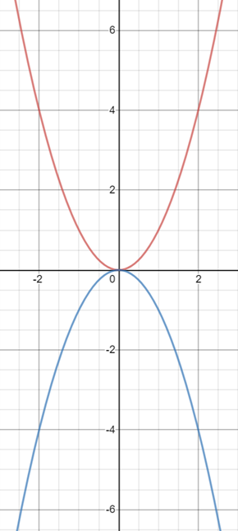
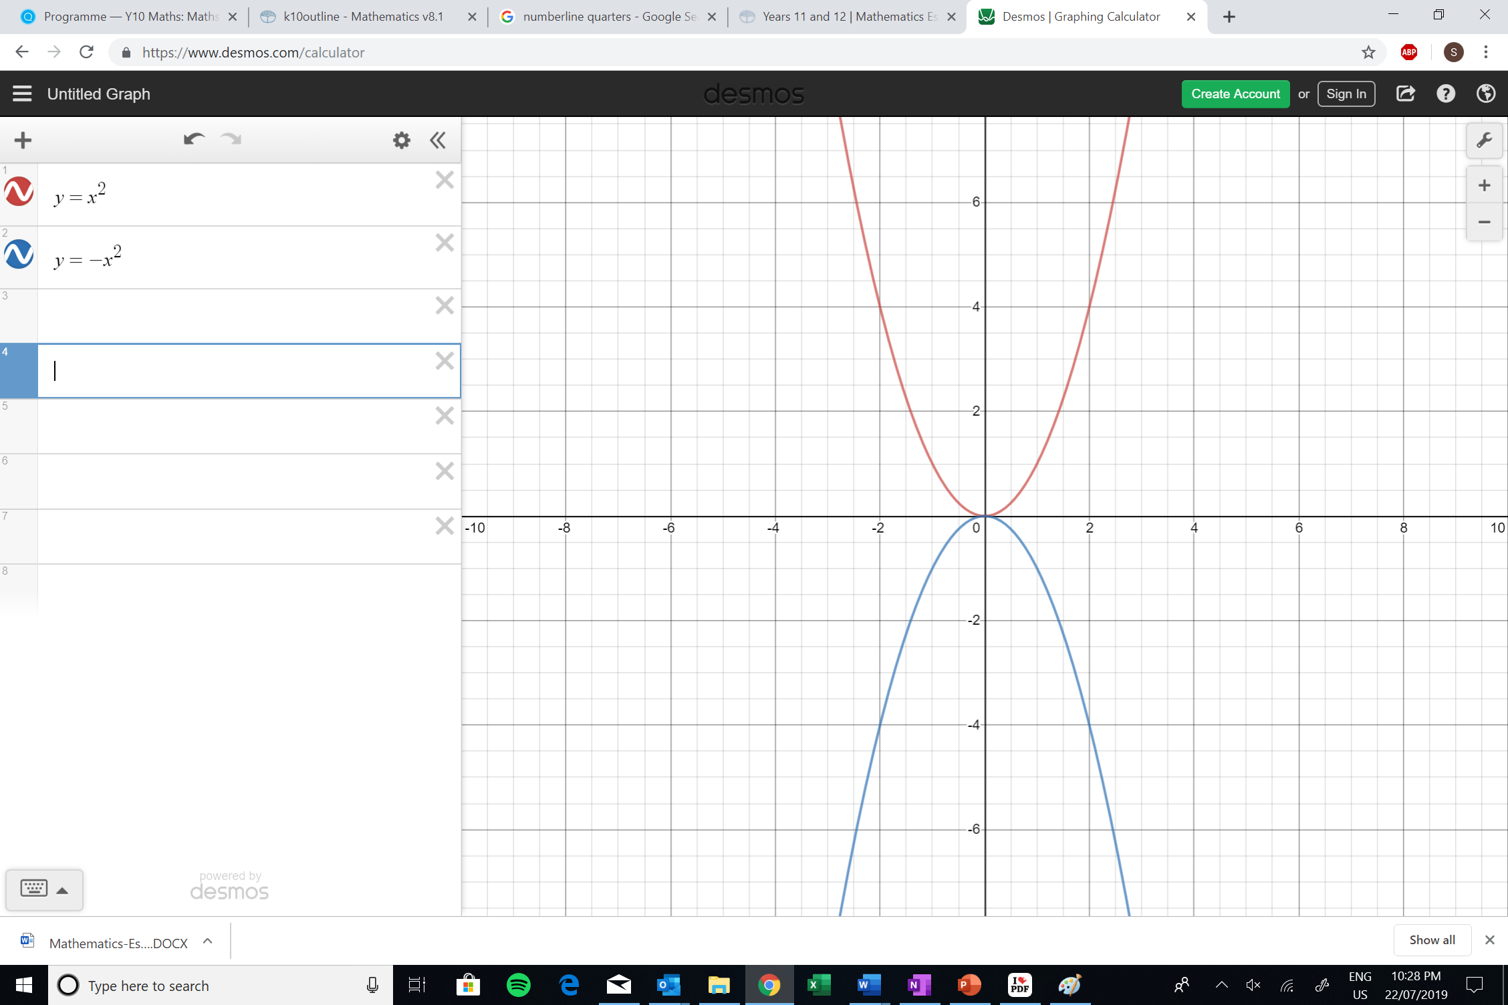
Topic: Parabolas
EQ: How do parabolas change positions?
What happens when you add a negative sign?
y = - x²
Gives an upside down parabola

Slide 7
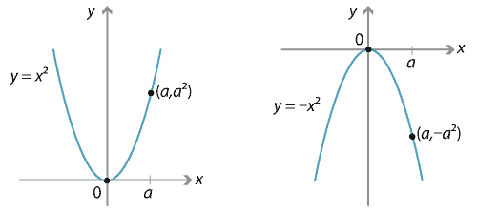
y = - x²
Gives an upside down parabola

Slide 8

Turning Point Form (& Reflection)
Making $a$ negative will flip the graph horizontally about the turning point.

Slide 9
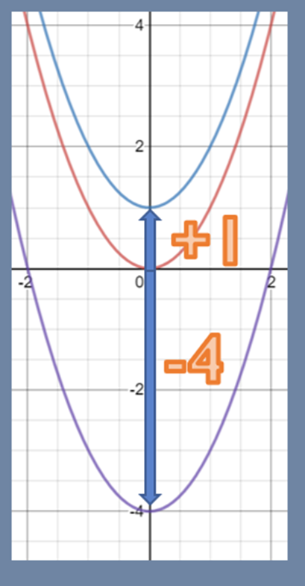
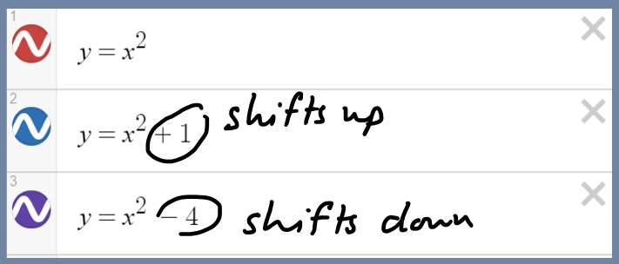
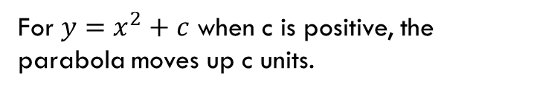

Topic: Parabolas
EQ: How do parabolas change positions?
What is the Turning Point form (& Vertical Translation)?
A change in $c$ will impact the vertical position of the graph (i.e. moving it up and down)
For $y=x^{2}+c$ when c is positive, the parabola moves up c units.

Slide 10
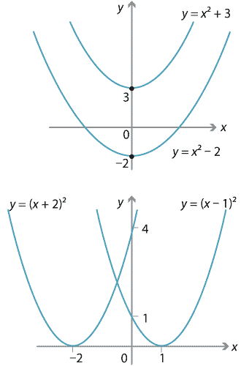
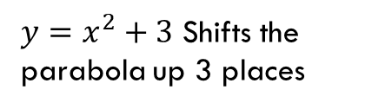
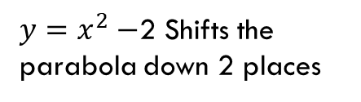
$y=x^{2}+3$ Shifts the parabola up 3 places
$y=x^{2}−$2 Shifts the parabola down 2 places

Slide 11
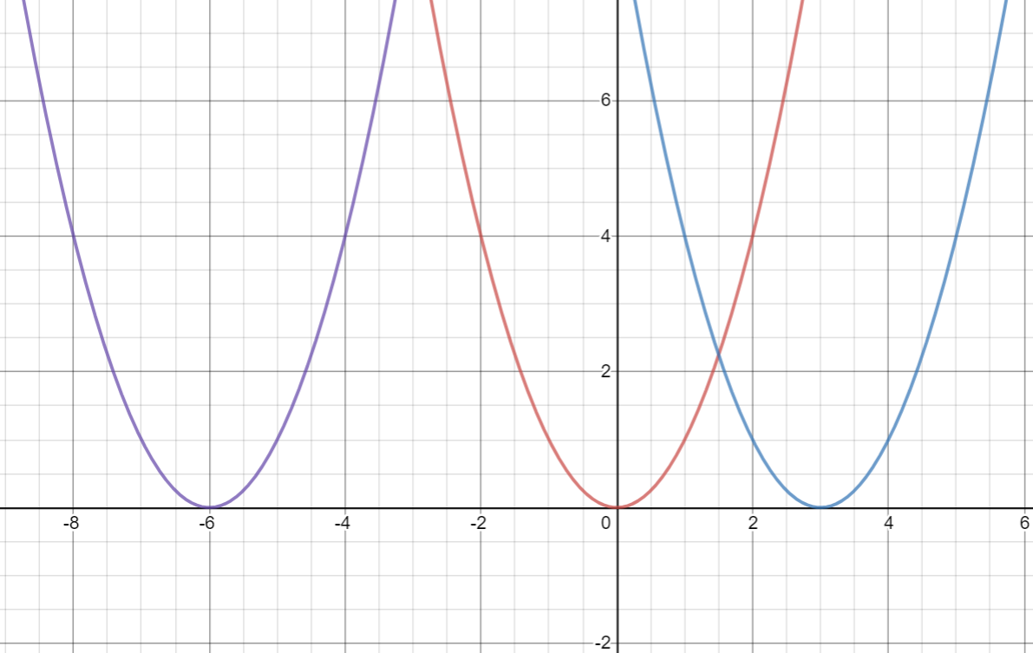
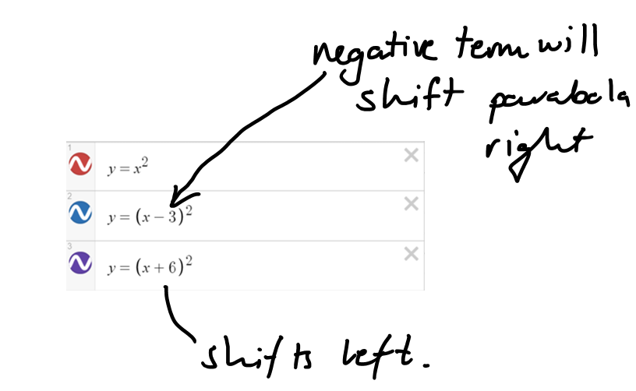

Topic: Parabolas
EQ: How do parabolas change positions?
What is the Turning Point form (& Horizontal Translation)?
A change in $b$ will impact the horizontal position of the graph (i.e. moving it left and right)

Slide 12
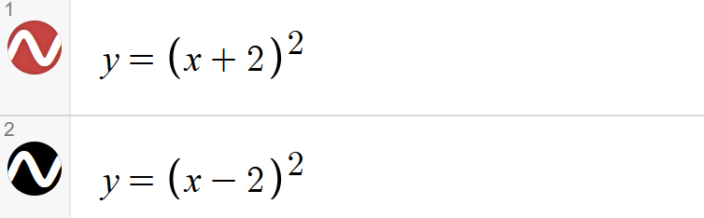
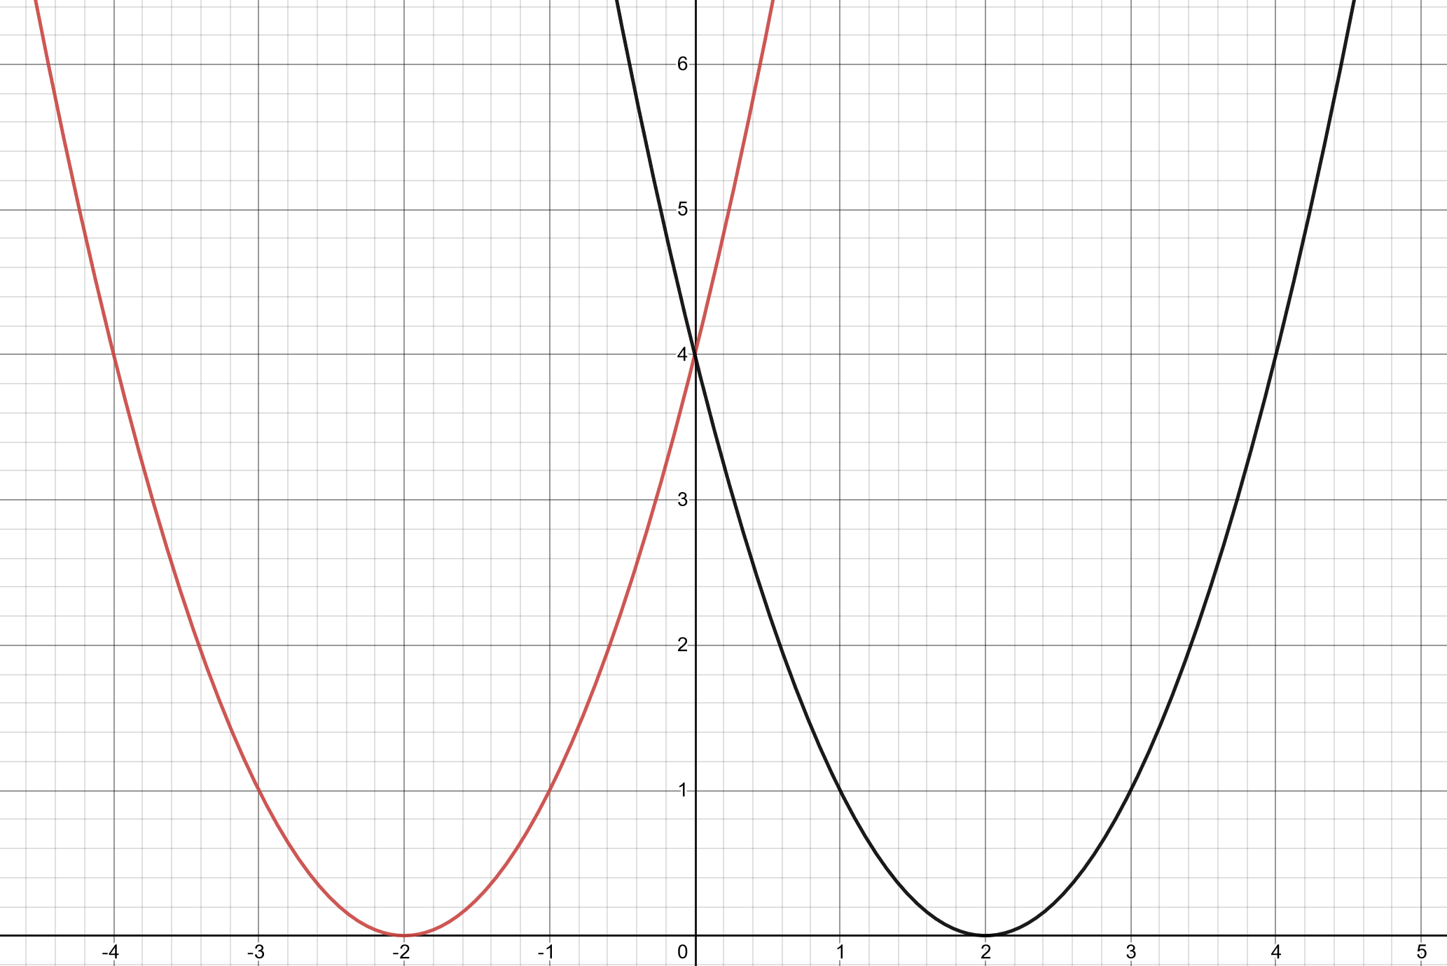
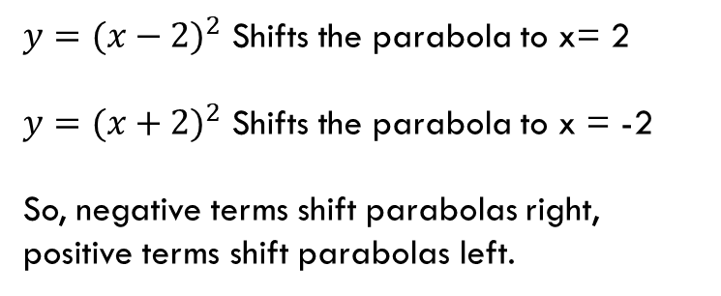
$y={(x−2)}^{2}$ Shifts the parabola to x= 2
$y={(x+2)}^{2}$ Shifts the parabola to x = -2
So, negative terms shift parabolas right, positive terms shift parabolas left.

Slide 13
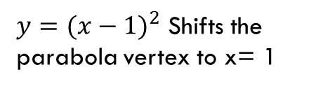
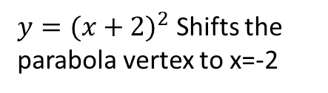
$y={(x+2)}^{2}$ Shifts the parabola vertex to x=-2
$y={(x−1)}^{2}$ Shifts the parabola vertex to x= 1

Slide 14
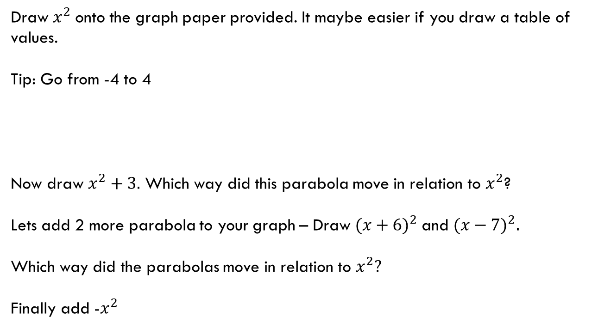
LHS:
Draw $x^{2}$onto the graph paper provided. It maybe easier if you draw a table of values.
Tip: Go from -4 to 4
Now draw $x^{2}+3.$ Which way did this parabola move in relation to $x^{2}$?
Lets add 2 more parabola to your graph – Draw ${(x+6)}^{2}$and ${(x−7)}^{2}.$
Which way did the parabolas move in relation to $x^{2}?$
Finally add -$x^{2}$
X | -4 | -3 | -2 | -1 | 0 | 1 | 2 | 3 | 4
y

Slide 15
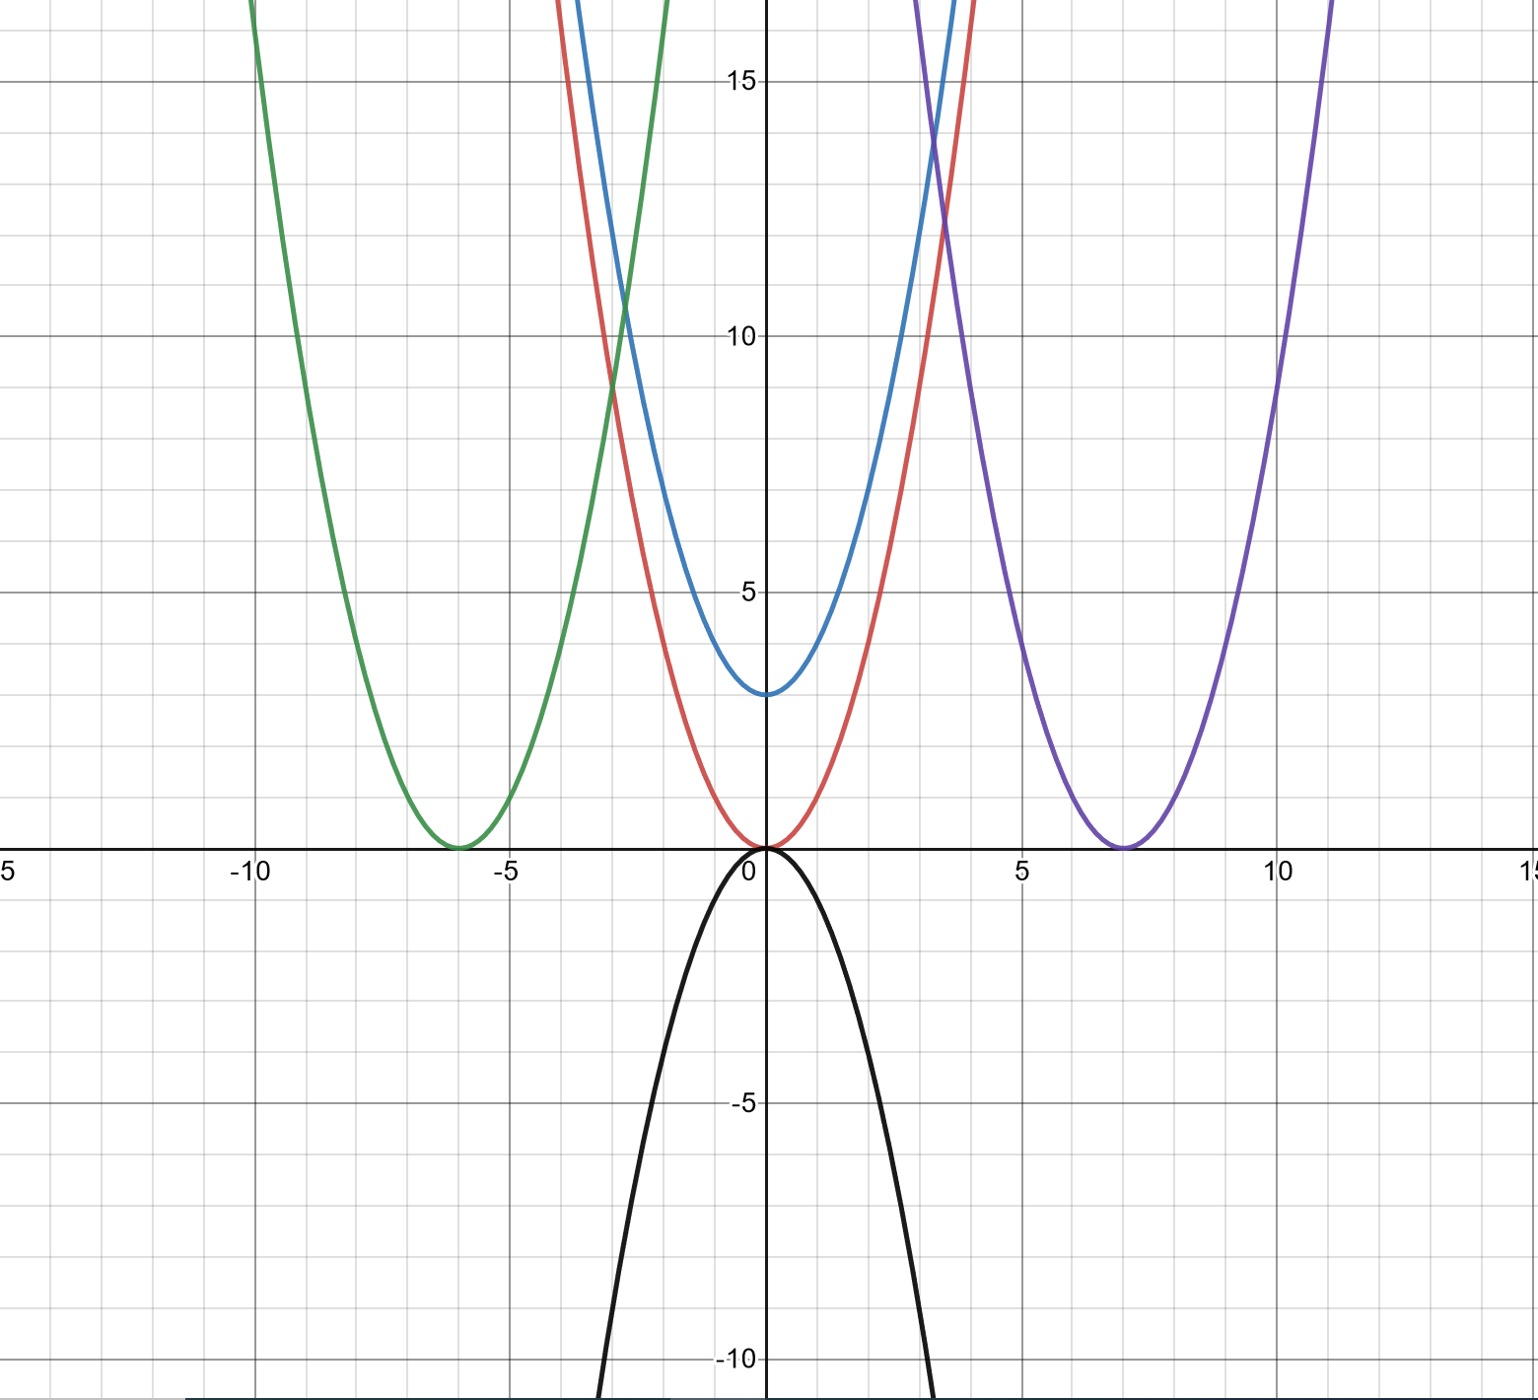
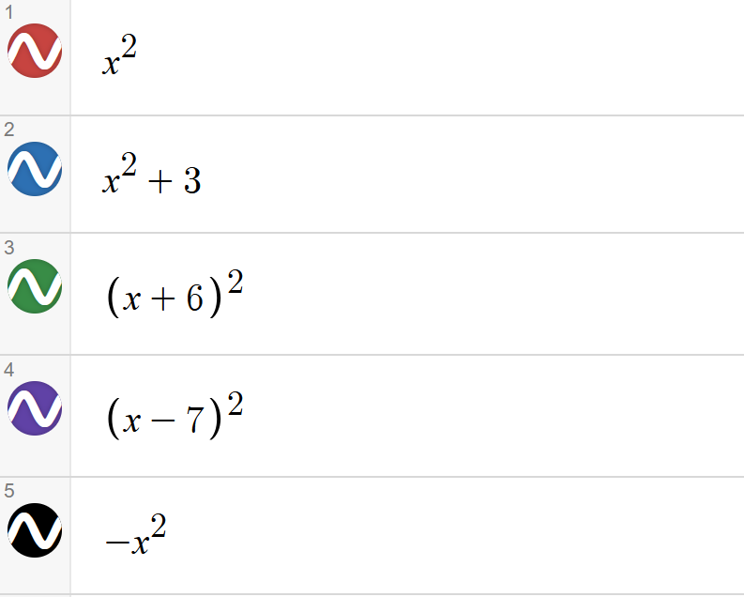
Solution

Slide 16
On your graph provided, plot the following points and connect with a smooth line
Rule: y = (x-2)²
X | -4 | -3 | -2 | -1 | 0 | 1 | 2 | 3 | 4
y | 36 | 25 | 16 | 9 | 4 | 1 | 0 | 1 | 4

Slide 17
In your books, create a table of values for the following rule, plot the following points and connect with a smooth line
Rule: y = (x+1)²
X | -4 | -3 | -2 | -1 | 0 | 1 | 2 | 3 | 4
y

Slide 18
In your books, create a table of values for the following rule, plot the following points and connect with a smooth line
Rule: y = (x-1)²
X | -4 | -3 | -2 | -1 | 0 | 1 | 2 | 3 | 4
y

Slide 19
In your books, create a table of values for the following rule, plot the following points and connect with a smooth line
Rule: y = (x+3)²
X | -4 | -3 | -2 | -1 | 0 | 1 | 2 | 3 | 4
y

Slide 20
In your books, discuss the impact of changing the number added or taken from y = (x+k)²

Slide 21
On your graph paper, plot the following points and connect with a smooth line
Rule: y = - (x+1)²
X | -4 | -3 | -2 | -1 | 0 | 1 | 2 | 3 | 4
y | 9 | 4 | 1 | 0 | 1 | 4 | 9 | 16 | 25

Slide 22
In your books, create a table of values for the following rule, plot the following points and connect with a smooth line
Rule: y = (x-4)² - 5
X | -4 | -3 | -2 | -1 | 0 | 1 | 2 | 3 | 4
y

